Slide 1
FEASIBILITY STUDIES & REPORTS
A SHORT INTRODUCTION

Slide 2

Define the term “Feasible”

Slide 3
It means..........
Capable of being
Accomplished
Brought about
Possible
Doable
Logically achievable
Practical
Workable

Slide 4
When taking decisions, do you assess the feasibility of your options, choice, etc?

Slide 5
Feasibility Study
A feasibility study provides information to decision makers about the practicality and potential success of several alternative solutions to a problem.
A feasibility study examines the viability of a proposal or idea.
Feasibility studies analyze the technical and economic practicalities of potential courses of action.

Slide 6
Feasibility Study
Feasibility studies aim to objectively and rationally uncover the strengths and weaknesses of the existing business or proposed venture, opportunities and threats as presented by the environment, the resources required to carry through, and ultimately the prospects for success.

Slide 7
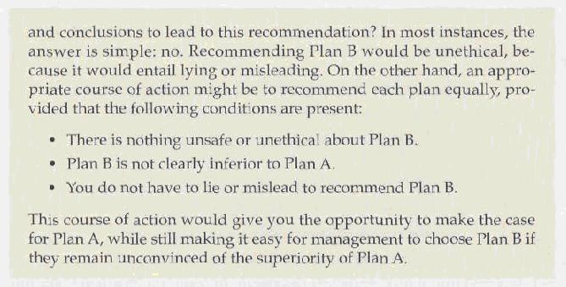
Feasibility Reports
Feasibility reports are written to report the results of a feasibility study.

Slide 8
Importance of Feasibility Studies
The feasibility report will look at how a certain proposal can work in a long-term basis or withstand financial risks that may come. It is also helpful in identifying potential cash flow.
Another significant purpose is that it helps planners focus on the project and narrow down the options.
When it comes to the operational aspect, the analysis determines whether the plan has the necessary resources for it to be workable.

Slide 9
Importance of Feasibility Studies
It will also help you figure out whether or not the people will support the resulting product or service.
You can have knowledge on the trends because a feasibility study looks at the current market and observe the projected growth of your target business sector.

Slide 10
Technical Feasibility Reports
A technical feasibility analysis is typically the result of significant research and development.
The criteria for acceptance of an activity or a product are determined by comparing the increased benefits with the increased cost in dollars plus the “disbenefits”.

Slide 11
Writing Feasibility Reports
INTRODUCTION:
Include the statement of the problem. Subject and purpose of the study and its authorization.
BACKGROUND:
Circumstances that created the necessity for this study.
DISCUSSION:
The technical and financial feasibility analysis. Individual analysis of each alternative or proposed activities.

Slide 12
Writing Feasibility Reports
Use facts, data, calculations, graphics to explain your analysis and conclusions.
CONCLUSIONS:
The natural results from the information presented in the discussion. This section is the link between the discussion and the recommendation.
RECOMMENDATIONS:
Give recommendations about the most suitable option. Also, elaborate on its feasibility.

Slide 13
Types of Feasibility
Technical feasibility
Is the project possible with current technology?
What technical risk is there?
Availability of the technology:
Is it available locally?
Can it be obtained?
Will it be compatible with other systems?
Economic feasibility
Is the project possible, given resource constraints?
What are the benefits?
Both tangible and intangible
Quantify them!
What are the development and operational costs?
Are the benefits worth the costs?
Schedule feasibility
Is it possible to build a solution in time to be useful?
What are the consequences of delay?
Any constraints on the schedule?
Can these constraints be met?
Operational feasibility
If the system is developed, will it be used?
Human and social issues…
Potential labour objections?
Manager resistance?
Organizational conflicts and policies?
Social acceptability?
legal aspects and government regulations?

Slide 14
Technical Feasibility
Is the proposed technology or solution practical?
Do we currently possess the necessary technology?
Do we possess the necessary technical expertise
…and is the schedule reasonable for this team?
Is relevant technology mature enough to be easily applied to our problem?
What kinds of technology will we need?
Some organizations like to use state-of-the-art technology
…but most prefer to use mature and proven technology.
A mature technology has a larger customer base for obtaining advice concerning problems and improvements.
Is the required technology available “in house”?
If the technology is available:
…does it have the capacity to handle the solution?
If the technology is not available:
…can it be acquired?

Slide 15
Economic Feasibility
Can the bottom line be quantified yet?
Very early in the project…
a judgment of whether solving the problem is worthwhile.
Once specific requirements and solutions have been identified…
…the costs and benefits of each alternative can be calculated
Cost-benefit analysis
Purpose - answer questions such as:
Is the project justified (I.e. will benefits outweigh costs)?
What is the minimal cost to attain a certain system?
How soon will the benefits accrue?
Which alternative offers the best return on investment?
Examples of things to consider:
Hardware/software selection
Selection among alternative financing arrangements (rent/lease/purchase)
Difficulties
benefits and costs can both be intangible, hidden and/or hard to estimate
ranking multi-criteria alternatives

Slide 16
Schedule Feasibility
How long will it take to get the technical expertise?
We may have the technology, but that doesn't mean we have the skills required to properly apply that technology.
May need to hire new people
Or re-train existing systems staff
Whether hiring or training, it will impact the schedule.
Assess the schedule risk:
Given our technical expertise, are the project deadlines reasonable?
If there are specific deadlines, are they mandatory or desirable?
If the deadlines are not mandatory, the analyst can propose several alternative schedules.
What are the real constraints on project deadlines?
If the project overruns, what are the consequences?
Deliver a properly functioning information system two months late…
…or deliver an error-prone, useless information system on time?
Missed schedules are bad, but inadequate systems are worse!

Slide 17
Operational Feasibility
How do end-users and managers feel about…
…the problem you identified?
…the alternative solutions you are exploring?
You must evaluate:
Not just whether a system can work…
… but also whether a system will work.
Any solution might meet with resistance:
Does management support the project?
How do the end users feel about their role in the new system?
Which users or managers may resist (or not use) the system?
People tend to resist change.
Can this problem be overcome? If so, how?
How will the working environment of the end users change?
Can or will end users and management adapt to the change?

Slide 18
Feasibility Study Contents
Purpose & scope of the study
Objectives (of the study)
who commissioned it & who did it,
sources of information,
process used for the study,
how long did it take,…
Description of present situation
organizational setting, current system(s).
Related factors and constraints.
Problems and requirements
What’s wrong with the present situation?
What changes are needed?
Objectives of the new system.
Goals and relationships between them
Possible alternatives
…including ‘do nothing’.
Criteria for comparison
definition of the criteria
Analysis of alternatives
description of each alternative
evaluation with respect to criteria
cost/benefit analysis and special implications.
Recommendations
what is recommended and implications
what to do next;
E.g. may recommend an interim solution and a permanent solution
Appendices
to include any supporting material.

Slide 19
Comparing Alternatives
How do we compare alternatives?
When there are multiple selection criteria?
When none of the alternatives is superior across the board?
Use a Feasibility Analysis Matrix!
The columns correspond to the candidate solutions;
The rows correspond to the feasibility criteria;
The cells contain the feasibility assessment notes for each candidate;
Each row can be assigned a rank or score for each criterion
e.g., for operational feasibility, candidates can be ranked 1, 2, 3, etc.
A final ranking or score is recorded in the last row.
Other evaluation criteria to include in the matrix
quality of output
ease of use
vendor support
cost of maintenance
load on system

Slide 20
Example Matrix

